Slide 1

Aditya University
School of Computing
Department of Computer Applications
IoT PROJECT – REVIEW-II
Project: Smart Water Level Indicator
Programme: MCA Year: 2 Semester: III
Review-II Presentation
Student Team:
1. Pravallika Vasa
2. Nissi Mogili
3. A.H.S Srivalli
4. K. Mahima
Project Guide: Miss Uppalapati Naga Ratna Kumari

Slide 2
Aditya University
School of Computing
Department of Computer Applications
Project Overview
Smart Water Level Indicator monitors the water level in a tank using an HC-SR04 ultrasonic sensor and Arduino UNO.
The sensor measures the distance between its position and the water surface.
Arduino calculates the water level and checks it against predefined threshold values.
Green, White, and Red LEDs provide visual indications; a buzzer gives an audible alert at the specified high-level condition.
The current prototype performs local monitoring without Wi-Fi, cloud storage, or a mobile application.
Main objective: reduce manual checking and help prevent water overflow and wastage.

Slide 3
Aditya University
School of Computing
Department of Computer Applications
Methodology – System Architecture
1. Sensing: HC-SR04 sends ultrasonic waves towards the water surface and receives the reflected echo.
2. Measurement: Arduino UNO reads the echo time and calculates the sensor-to-water distance.
3. Processing: Water Level = Tank Height − Measured Distance.
4. Decision: The calculated level is compared with predefined thresholds.
5. Output: Arduino controls the Green, White, and Red LEDs and activates the buzzer when the specified threshold is reached.
6. Monitoring: The measurement and output process repeats continuously.
HC-SR04
Sensor
Arduino UNO
Processing
Threshold
Checking
LEDs +
Buzzer

Slide 4
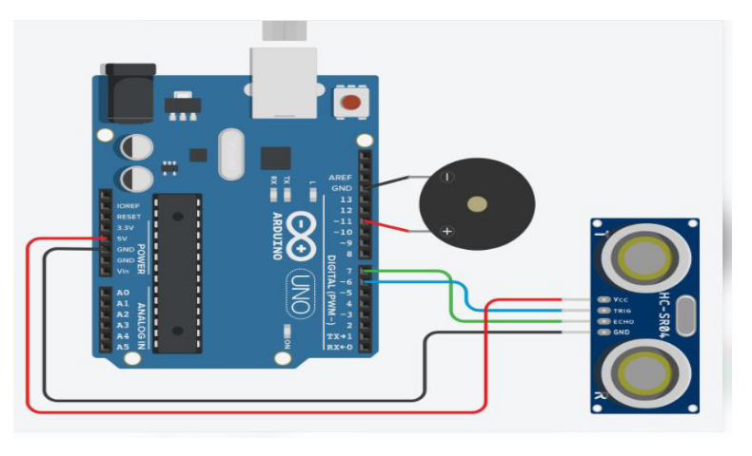
Aditya University
School of Computing
Department of Computer Applications
Hardware Development and Connections
Controller: Arduino UNO – processes sensor readings and controls output devices.
Sensor: HC-SR04 – VCC to 5V, GND to GND, TRIG to D9, and ECHO to D10.
LEDs: Green to D2, White to D3, and Red to D4 through current-limiting resistors; LED cathodes to GND.
Buzzer: Positive terminal to D8 and negative terminal to GND.
Power: Arduino UNO operates through a 5V USB supply; components are connected using jumper wires.
Circuit diagram from the project report

Slide 5
Aditya University
School of Computing
Department of Computer Applications
Software Development – Arduino Program
Development environment: Arduino IDE; programming language: Arduino C/C++.
setup(): initializes the ultrasonic sensor, three LEDs, and buzzer pins.
loop(): repeatedly reads sensor data and monitors the water level.
readDistance(): sends the trigger pulse and measures echo time using pulseIn().
calculateWaterLevel(): subtracts measured distance from tank height.
checkWaterLevel(): compares the calculated value with predefined thresholds.
controlLEDs() and controlBuzzer(): operate the visual indicators and audible alert.
No external library is required for basic sensor measurement; processing is local on Arduino UNO.

Slide 6
Aditya University
School of Computing
Department of Computer Applications
Sensor Data Acquisition and Water-Level Calculation
Arduino sends a trigger signal to the HC-SR04 sensor.
The sensor emits ultrasonic waves; the waves reflect from the water surface and return as an echo.
Arduino reads the echo duration and calculates the distance to the water surface.
The water level is calculated using the tank height and measured distance:
Water Level = Tank Height − Measured Distance
The result is checked against the threshold values, and the corresponding LED/buzzer output is activated.
All data processing takes place locally; no database, external server, or cloud platform is used.

Slide 7
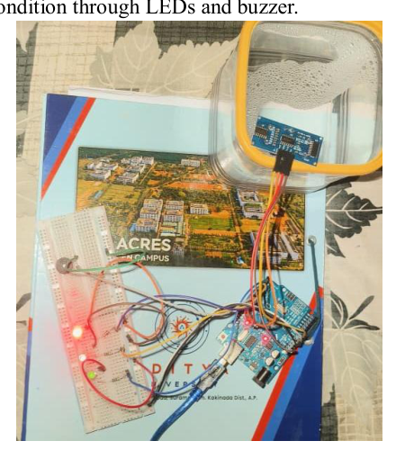
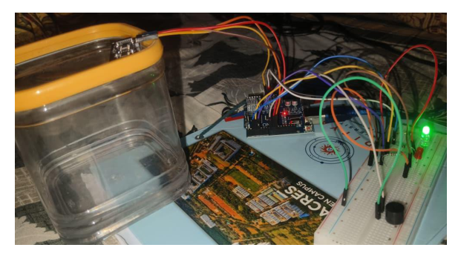
Aditya University
School of Computing
Department of Computer Applications
Developed Prototype – Hardware Integration
The prototype integrates Arduino UNO, HC-SR04 ultrasonic sensor, three LEDs, resistors, buzzer, and jumper wires.
The ultrasonic sensor is positioned facing the water surface; Arduino controls the indicators based on sensor readings.
Assembled prototype
Working demonstration

Slide 8
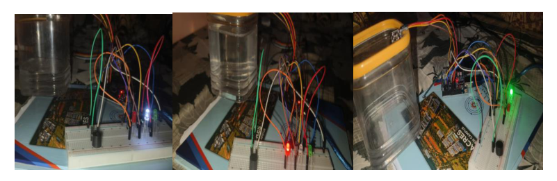
Aditya University
School of Computing
Department of Computer Applications
Output Indications – Visual and Audio Alerts
Low-level test: 2 cm – Green LED ON.
Medium-level test: 5 cm – White LED ON.
High-level test: 8 cm – Red LED and buzzer ON.
The LEDs provide a visual indication, while the buzzer provides an audible alert at the specified threshold.
Output photographs included in the project report

Slide 9
Aditya University
School of Computing
Department of Computer Applications
Testing Methodology and Functional Test Cases
Test environment: Arduino UNO, ultrasonic sensor, LEDs, buzzer, and a water container.
Procedure: vary the water level and observe sensor readings, water-level calculation, LED indication, and buzzer response.
Evaluation: verify distance measurement, threshold decisions, output operation, and continuous monitoring.
Functional test cases TC01–TC06: system power-on, sensor reading, water-level calculation, threshold condition, LED indication, and continuous monitoring.
Reported status: all six functional test cases are marked Pass.

Slide 10
Aditya University
School of Computing
Department of Computer Applications
Experimental Results, Limitations and Future Scope
Observed test responses: 2 cm – Green LED; 5 cm – White LED; 8 cm – Red LED + buzzer.
Performance evaluation in the report: container height 10.5 cm; low level 2 cm; medium level 6 cm; high level 7 cm or above.
Power supply: 5V USB. Continuous operation was checked. Data transmission is not applicable in the current build.
Limitations: readings may vary with water-surface movement or sensor placement; no Wi-Fi, remote monitoring, or cloud storage; small-scale prototype.
Future scope: Wi-Fi connectivity, mobile alerts, improved sensors, automatic pump control using a relay, battery backup, and larger-tank deployment.

Slide 11
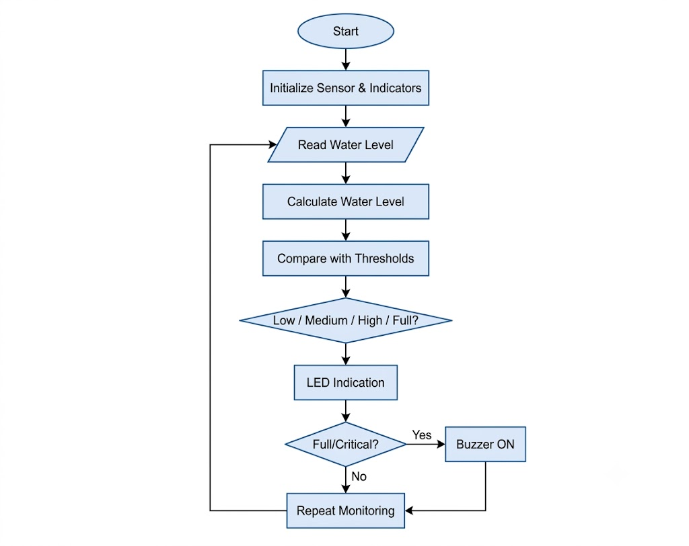
Aditya University
School of Computing
Department of Computer Applications
Conclusion and 20-Minute Live Demonstration
Conclusion: The prototype successfully demonstrates local water-level monitoring using Arduino UNO and an ultrasonic sensor, with LED and buzzer outputs.
The project reduces the need for manual checking and provides a simple, low-cost alert mechanism.
LIVE DEMO PLAN – 20 MINUTES
0–3 min: Explain components, circuit connections, and power supply.
3–8 min: Show sensor distance readings and water-level calculation.
8–14 min: Change water level and demonstrate Green, White, and Red LED responses.
14–17 min: Demonstrate buzzer activation at the high-level threshold.
17–20 min: Explain test cases, observed limitations, and answer questions.

Slide 12
Aditya University
School of Computing
Department of Computer Applications
Thank You
Smart Water Level Indicator | Review-II

